Slide 1
Organizational Behaviour

Slide 2
Organizational Behavior
A field of study that investigates the impact that individuals, groups, and structure have on behavior within organizations, for the purpose of applying such knowledge toward improving an organization’s effectiveness.
Work in an organization
A consciously coordinated social unit composed of two or more people that functions on a relatively continuous basis to achieve a common goal or set of goals.

Slide 3
What Managers Do?
They get things done through other people.
Management Activities:
Make decisions
Allocate resources
Direct activities of others to attain goals

Slide 4
Managers vs. Leaders
Major Differences (Vineet Nayer, HBR, 2013)
Counting value vs Creating value
Circles of power vs Circles of influence
Managing work vs Leading people
Dealing with complexity vs Dealing with uncertainty
Doing things right vs doing right things
Maintaining vs Developing

Slide 5
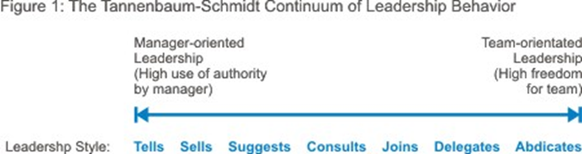

Slide 6
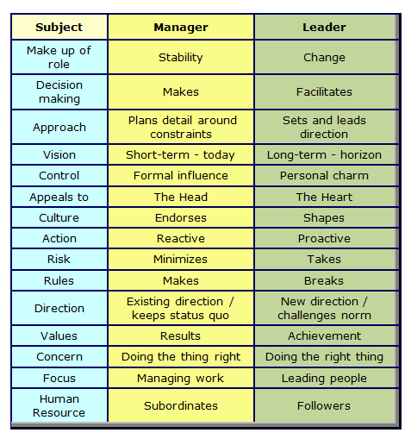

Slide 7
Ted Talk
Why Good Leaders make you feel safe: Simon Sinek (Leadership Expert)
What makes a great leader? Management theorist Simon Sinek suggests, it’s someone who makes their employees feel secure, who draws staffers into a circle of trust. But creating trust and safety — especially in an uneven economy — means taking on big responsibility.

Slide 8
Management Functions
Control
Plan
Lead
Organize

Slide 9
Management Functions: Plan
Plan
Control
A process that includes defining goals, establishing strategy, and developing plans to coordinate activities.
As managers advance, they do this function more often.
Lead
Organize

Slide 10
Management Functions: Organize
Control
Plan
Lead
Determining what tasks are to be done, who is to do them, how the tasks are to be grouped, who reports to whom, and where decisions are to be made.
Organize

Slide 11
Management Functions: Lead
Control
Lead
A function that includes motivating employees, directing others, selecting the most effective communication channels, and resolving conflicts.
It is about PEOPLE!
Plan
Organize

Slide 12
Management Functions: Control
Control
Monitoring performance, comparing actual performance with previously set goals, and correcting any deviation.
Lead
Lead
Organize

Slide 13

Mintzberg’s Managerial Roles
Discovered ten managerial roles
Separated into three groups:
Interpersonal
Informational
Decisional
E X H I B I T 1–1

Slide 14
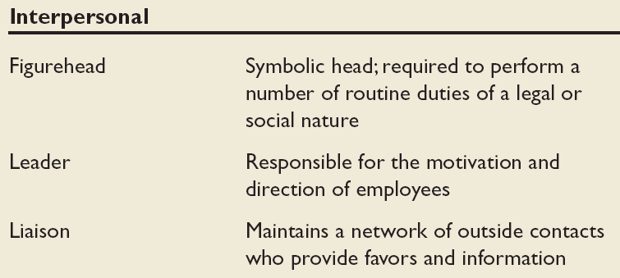
Mintzberg’s Managerial Roles: Interpersonal
Source: Adapted from The Nature of Managerial Work by H. Mintzberg. Copyright © 1973 by H. Mintzberg. Reprinted by permission of Pearson Education.

Slide 15
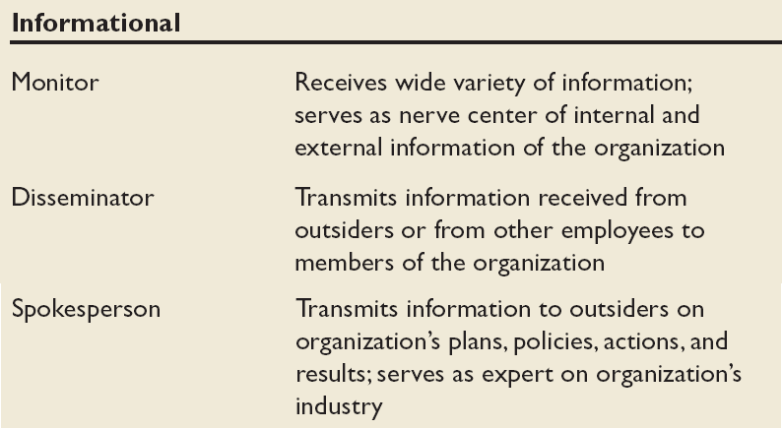
Mintzberg’s Managerial Roles: Informational
Source: Adapted from The Nature of Managerial Work by H. Mintzberg. Copyright © 1973 by H. Mintzberg. Reprinted by permission of Pearson Education.

Slide 16
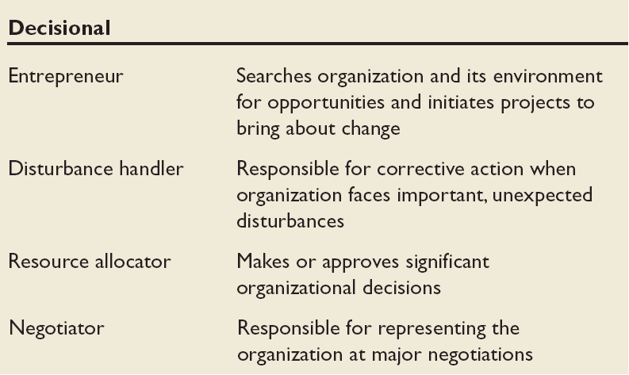
Mintzberg’s Managerial Roles: Decisional
Source: Adapted from The Nature of Managerial Work by H. Mintzberg. Copyright © 1973 by H. Mintzberg. Reprinted by permission of Pearson Education.

Slide 17
Katz’s Essential Management Skills
Technical Skills
The ability to apply specialized knowledge or expertise
Human Skills
The ability to work with, understand, and motivate other people, both individually and in groups
Conceptual Skills
The mental ability to analyze and diagnose complex situations

Slide 18
Luthans’ Study of Managerial Activities
Is there a difference in frequency of managerial activity between effective and successful managers?
Four types of managerial activity:
Traditional Management
Decision-making, planning, and controlling.
Communication
Exchanging routine information and processing paperwork
Human Resource Management
Motivating, disciplining, managing conflict, staffing and training.
Networking
Socializing, politicking, and interacting with others.

Slide 19
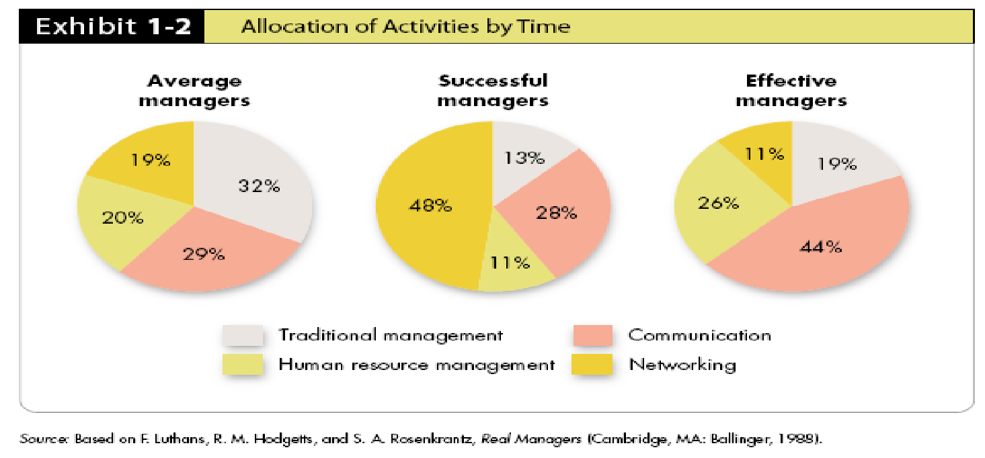
Successful vs. Effective Allocation by Time
Managers who promoted faster (were successful) did different things than did effective managers (those who did their jobs well)

